Slide 1
Chongqing University of Technology
ATAI
Advanced Technique of Artificial Intelligence
Chongqing University of Technology
ConsisRec: Enhancing GNN for Social Recommendation via Consistent Neighbor Aggregation
^{Liangwei Yang, Zhiwei Liu,}
^{Yingtong Dou}
Department of Computer Science,
University of Illinois at Chicago
{lyang84,zliu213,ydou5}@uic.edu
^{Jing Ma}
^{Business School,}
^{Sichuan University}
^{jingma@stu.scu.edu.cn}
^{Philip S. Yu}
Department of Computer Science,
University of Illinois at Chicago
^{psyu@uic.edu}
——SIGIR 2021
2021.5.11 • ChongQing
Reported by Sijin Liu

Slide 2
Chongqing University of Technology
ATAI
Advanced Technique of Artificial Intelligence
Chongqing University of Technology
1.Introduction
2.Method
3.Experiments
4.Conclusion

Slide 3
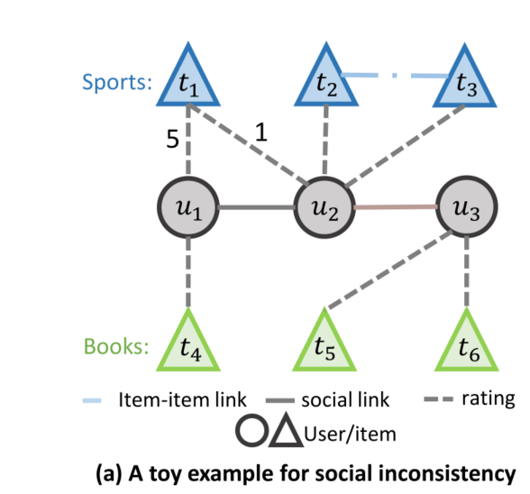
Introduction
Due to the high cost of data collection, most existing recommender systems suffer from the cold-start problem. To alleviate it, we can incorporate the social information among users, which functions as a side information of the user-item interaction. Therefore, fusing the social links with user-item interactions is advantageous to improve the recommendation performance, which is defined as the social recommendation problem.
The social inconsistency can be categorized into two levels:
• Context-level: It indicates that users connected in a social graph
may have discrepant item contexts.
• Relation-level: There are multiple relations when simultaneously
modeling social graph and user-item graph.

Slide 4
Method
Social recommendation problem consists of two set of entities, a user set $U=\{ u_{1},u_{2},…,u_{m}\}$ and an item set $T=\{ t_{1},t_{2},…,t_{n}\}$.
It includes two types of information, an incomplete rating matrix $R∈ℝ^{m×n}$and the user-user social graph $G_{s}=\{U,ℇ_{s}\}$. The Rating $R_{u,t}$denotes user $u$’s preference to item $t$. An social edge$\left(u_{i}, u_{j}\right)∈ ℇ_{s}$ indicates that user $i$ has an social connection with$j$.
we solve social recommendation problem by constructing a heterogeneous graph $G = \{V,ℇ_{r}|{R \atop r=1}\},$ where $V$denotes both user and item nodes and $ℇ_{r}$denotes edges upon relation $r$. Besides user-user and item-item links, we also distinguish the user-item links by their rating scores.

Slide 5
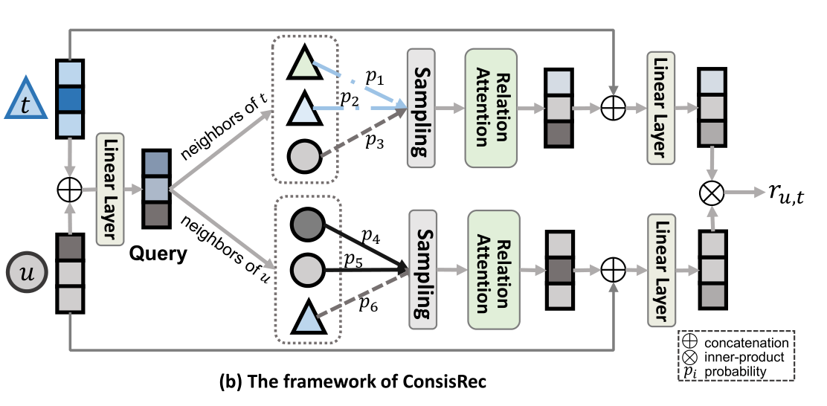
Method
Embedding Layer
Following existing works ,we maintain an embedding layer $E ∈ R^{d×(m+n)},$each column of which represents the trainable embedding for each node. We can index it to retrieve the embedding of a node $v ∈ U ∪ T$as $e_{v}∈ R^{d}$. Apart from node embeddings, we also train a relation embedding vector for each relation $r$ to characterize relation-level social inconsistency, denoted as $e_{r}$

Slide 6
Method
Query Layer
ConsisRec employs a query layer to exclusively select consistent neighbors for the query pair $(u,t)$. It generates a query embedding by mapping the concatenation of user and item embeddings:

Slide 7
Method
Neighbor Sampling
The sampling probability for neighbor node $i$ at $l$-th layer is defined by the consistency score between query $q$ and all the neighbors as:

Slide 8
Method
Relation Attention
The framework of ConsisRec to aggregate node embeddings can be formalized as:
Rating Prediction and Optimization

Slide 9
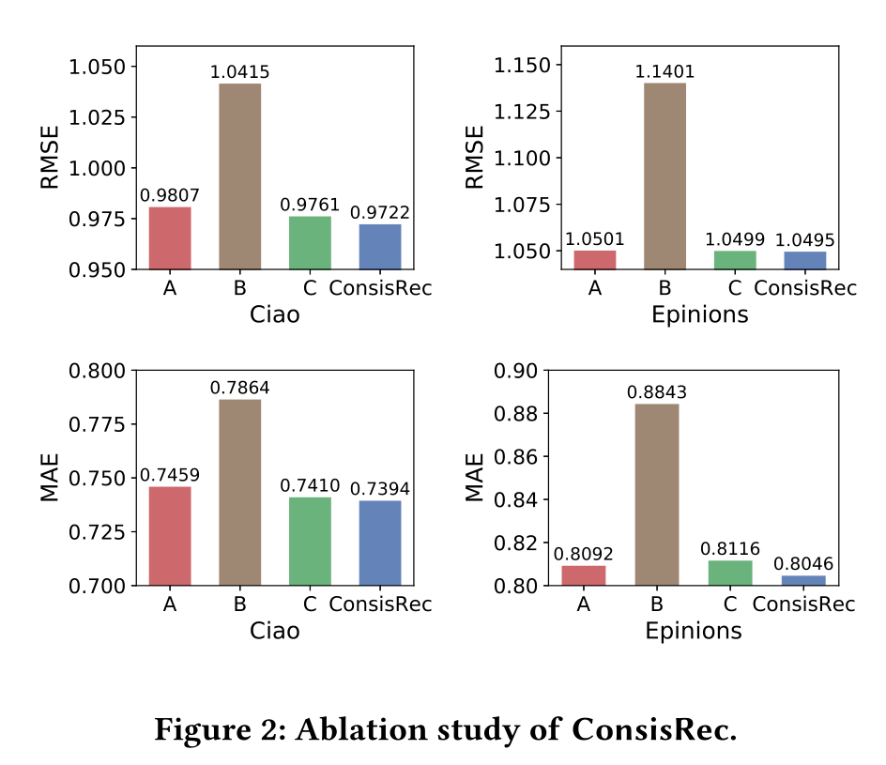
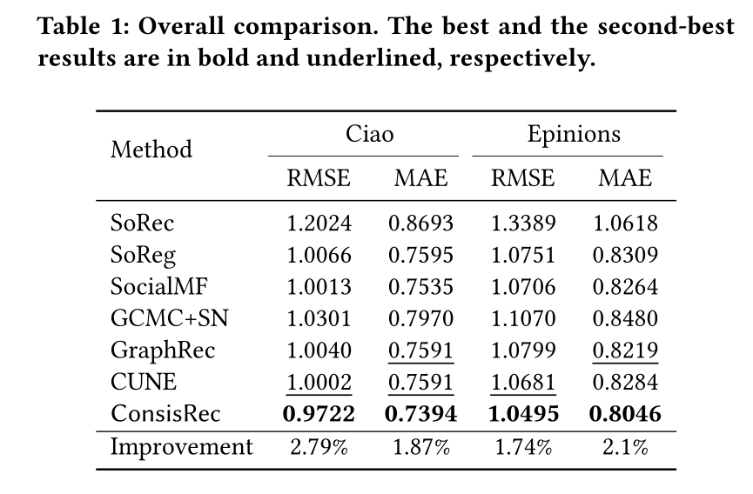
Experiments

Slide 10
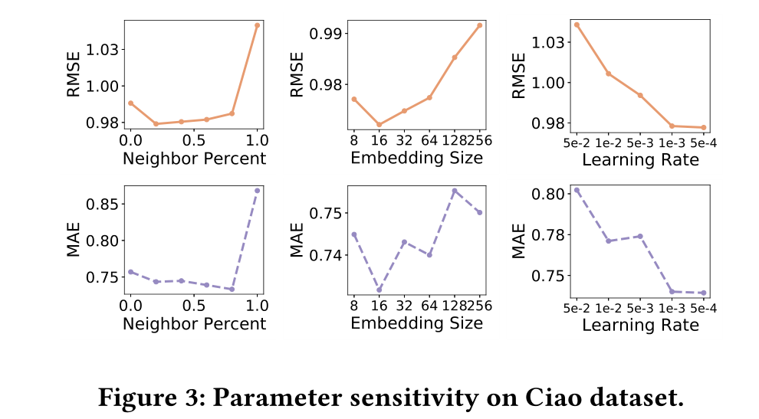
Experiments

Slide 11
Summary
In this paper, we identify the social inconsistency problem related to social recommendation. The proposed ConsisRec contains three modifications on GNN to tackle the social inconsistency problem. Experiment results on two real-world datasets show the effectiveness of ConsisRec. Future work includes better ways to filter informative neighbors and identify the inconsistency problems inherited in other graph related research directions.

Slide 12
Thank you!

